Slide 1




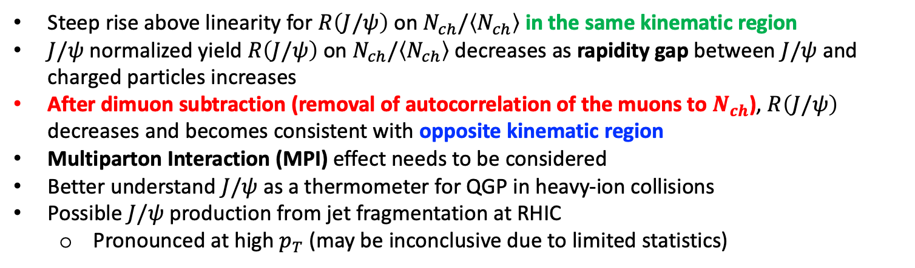
PHENIX Standalone Preliminary Results
VTX Barrel
$J/ψ→μ^{+}+ μ^{−}$
(-)
(-)
$$z$$
FVTX South Arm
FVTX North Arm
Steep rise above linearity for $R\left(J/ψ\right)$ on $N_{ch}/\left\langle N_{ch}\right\rangle$ in the same kinematic region
$J/ψ$ normalized yield $R\left(J/ψ\right)$ on $N_{ch}/\left\langle N_{ch}\right\rangle$ decreases as rapidity gap between $J/ψ$ and charged particles increases
After dimuon subtraction (removal of autocorrelation of the muons to $N_{ch}$), $R\left(J/ψ\right)$ decreases and becomes consistent with opposite kinematic region
Multiparton Interaction (MPI) effect needs to be considered
Better understand $J/ψ$ as a thermometer for QGP in heavy-ion collisions
Possible $J/ψ$ production from jet fragmentation at RHIC
Pronounced at high $p_{T}$ (may be inconclusive due to limited statistics)
1

Slide 2
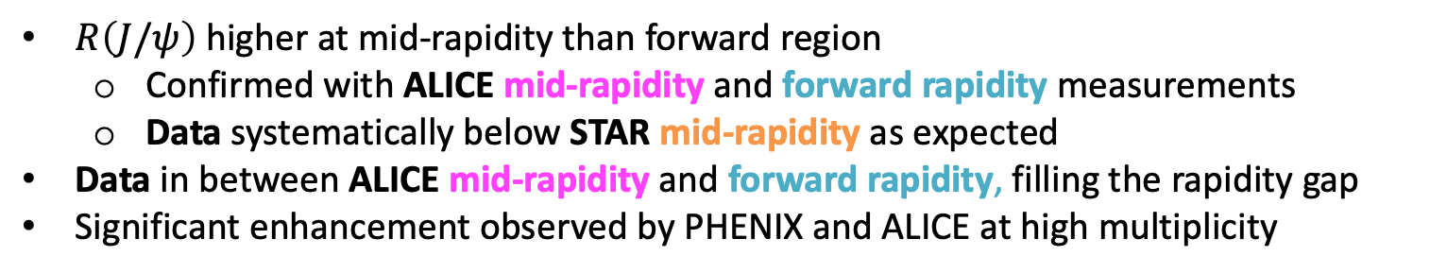
Comparison with Other Experiments
ALICE: Phys. Lett. B 498810 (2020) 135758
STAR: Phys. Lett. B 786 (2018) 87-93
$R\left(J/ψ\right)$ higher at mid-rapidity than forward region
Confirmed with ALICE mid-rapidity and forward rapidity measurements
Data systematically below STAR mid-rapidity as expected
Data in between ALICE mid-rapidity and forward rapidity, filling the rapidity gap
Significant enhancement observed by PHENIX and ALICE at high multiplicity
2

Slide 3
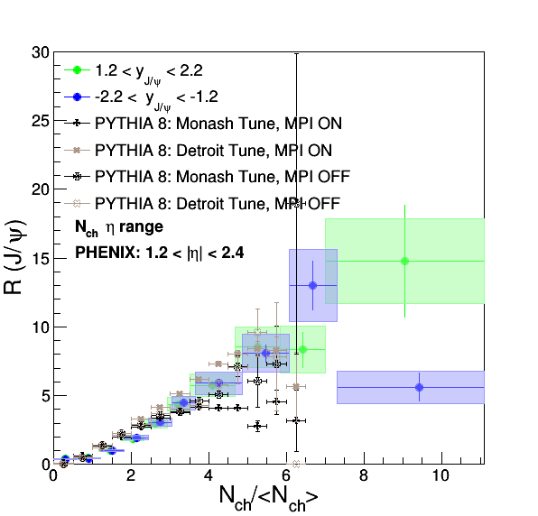
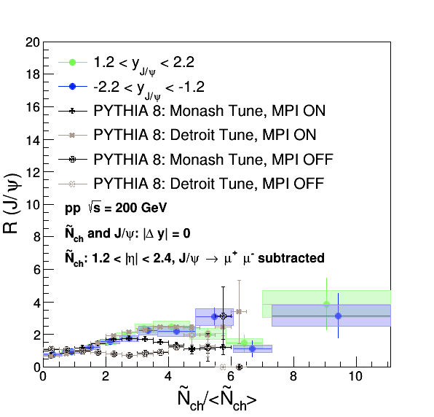
Comparison with PYTHIA 8 Simulations
Comparison before and after dimuon subtraction with PYTHIA 8 Monash and Detroit Tunes with MPI ON and OFF in the generated level
PYTHIA 8 Detroit Tunes with MPI ON best describes the data
3

